Slide 1


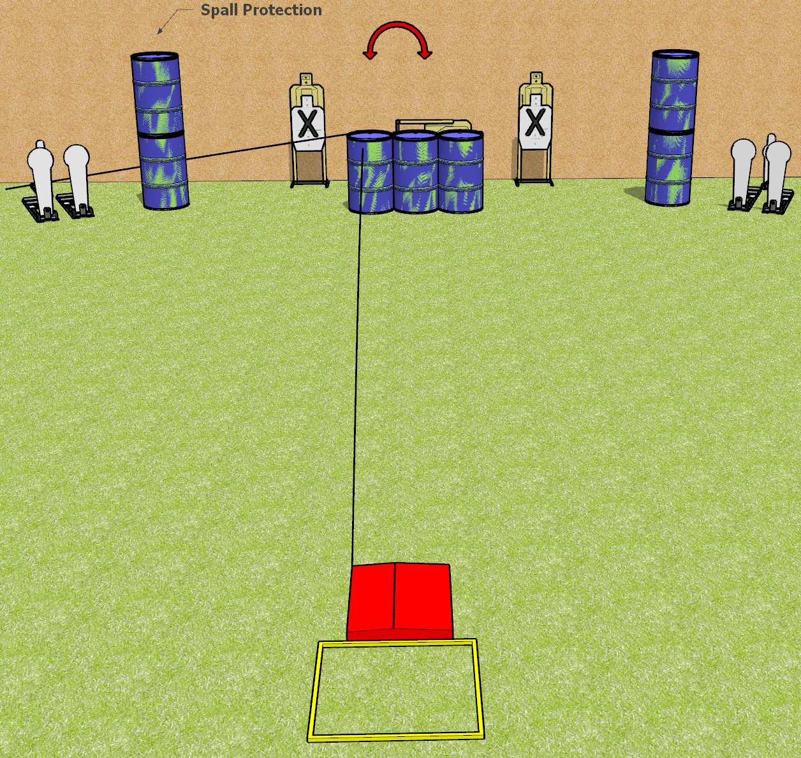
 | Dothan Gun Club – USPSA Match Wait, what? Course Designer : Keanu Sy/Drew Coleman
START POSITION : Standing with both feet on X’s, wrists above shoulders
GUN READY CONDITION : Pistol loaded and holstered. PCC loaded, buttstock on belt, safety on. |  | SCORING: Comstock, 12 rounds TARGETS: 3 paper, 6 Steel SCORED HITS: Best 2 on paper, steel until down START-STOP: Audible, last shot RULES: The paper targets are one array and the steel are another. The stomp pad is not part of the shooting area. You may not touch the stomp box prior to the start signal.
STAGE PROCEDURE: Engage the steel or the paper, perform a mandatory reload, then engage the remaining array.

Slide 2
Wait, What?
Written Stage Briefing
Wait, What? is a 12 round, 60 point, Comstock speed shoot. There are three USPSA targets, four colt poppers, and two mini poppers. The best two hits on paper will score. Steel must fall to score. The start signal is audible. The poppers are one array and the paper, including the swinger, is another.
Handgun start position is standing in shooting box with wrists above respective shoulders. Handgun is loaded and holsters.
PCC start position is standing in shooting box with buttstock on belt. Carbine is loaded, held with both hands, safety on.
Upon start signal, engage the steel or the paper, perform a mandatory reload, then engage the remaining array. The left mini popper or the stomp pad will activate the swinger.
The stomp pad is not part of the shooting area. You may not touch the stomp box prior to the start signal.

